Slide 1
Return-Exchange Incidence on Items - Item Issue
How to bring us forward!
Comprehensive Guide to Identifying, Registering, and Resolving Customer Item Issues

Slide 2

Training are not an expense, but an investment in Human Capital
Transcom
Roy H Williams, 2001
|

Slide 3
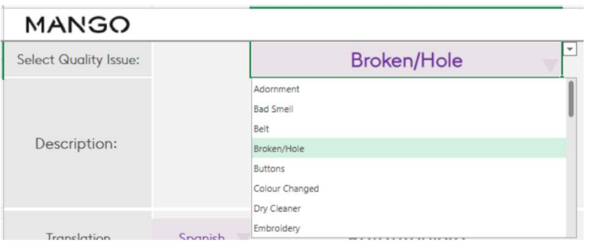

Types of Issues
Quality Issues: These stem from problems with the manufacturing process.
Defects present at the point of purchase: These are flaws that are evident when the customer first receives the item.
Defects arising after use: These are problems that develop during the normal use of the item.
Examples: Holes, twisted seams, faulty zippers, discoloration, etc.
Refer to "Quality Issue Reason Definitions.xlsx" for a complete and detailed guide with visual examples.
|

Slide 4
Types of Issues
Other Issues: These are issues that are not related to the item's manufacturing quality.
Damages caused by the courier: Damage that occurred during shipping and handling.
Wrong item shipped: The customer received an item different from what they ordered.
Image discrepancy: The item received does not match the image shown online or in the app.
Mismatched set: Components of a set don't match (e.g., different sizes).
Missing part: A part of the item is missing (e.g., a belt with a coat).
Item with alarm: A security tag was left on the item.
Incorrect color or size: The item's color or size does not match the order.
(Explanation: This slide clearly differentiates between manufacturing defects and other common issues.)
|

Slide 5
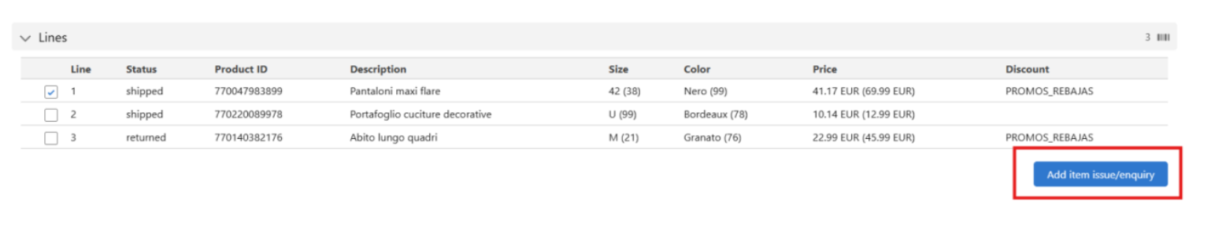
How to Register Issues
Classification: When registering the issue, use this path: Return-Exchange; Contact reason Incidence on items; subdetail Item issue. This ensures accurate categorization.
Register the specific item the customer is complaining about in Lines . This is essential for tracking individual item issues.
|

Slide 6
Online Orders - Quality Issues
Clearly indicate the full order number in the case details.
In the "Order > Lines" section, find and select the specific defective item, and then click the "Add item issue/enquiry" button.
In the "Type" field, choose "Quality Issue."
In the "Reason" field, select the most accurate quality issue reason. Consult the "Quality Issue Reason Definitions.xlsx" for a complete list and definitions.
Add detailed comments in the "Comments" field if necessary. This provides crucial context for the product teams.
If the defective MANGO item has caused damage to other non-MANGO items, be sure to check the "Damaged No Mango Items" box and follow the related procedure.
|

Slide 7
Online Orders - Other Issues
Indicate the order number in the case.
In the "Order > Lines" section, select the item with the issue and click "Add item issue/enquiry."
In the "Type" field, select "Other issue."
In the "Reason" field, select the specific reason for the "Other issue." Refer to the earlier "Types of Issues" slide for guidance.
Add comments in the "Comments" field if necessary.
|

Slide 8
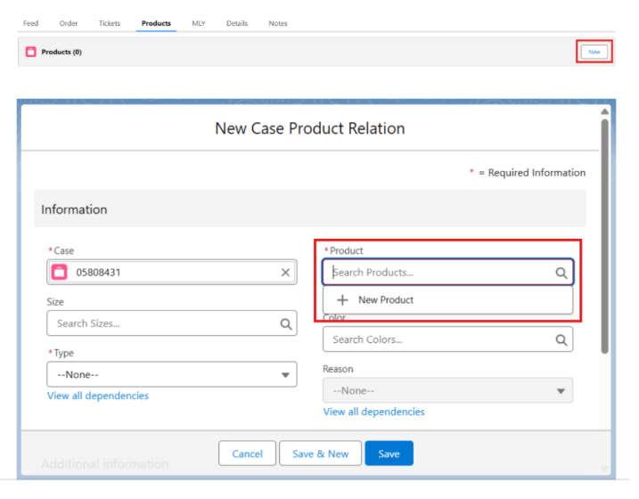
Store Purchases
Register the issue in the "Products" tab of the case, and search for the item's reference. If not found, you may need to create a new product sheet.
In the "Type" field, select "Quality issue" or "Other issue," whichever applies.
In the "Reason" field, select the most suitable reason based on the issue.
|

Slide 9
Procedure
The specific procedures for resolving the issue will vary based on whether the item was purchased online (including iPad orders) or in a physical store.
There are distinct workflows for handling:
Quality issues - Item bought Online or Ipad order
Quality issues - Item bought in store
|

Slide 10
Importance of Feedback
Correctly registering quality issues is absolutely crucial. This provides direct feedback to product teams.
Accurate and detailed information in issue reports is vital. It ensures that the correct problems are identified and addressed.
Helps identify and systematically solve recurring problems. This leads to continuous product improvement.
Improves product quality and influences the design of future collections. Feedback directly impacts future offerings.
Ultimately, prioritizes a positive customer experience. Satisfied customers build brand loyalty.
|

Slide 11
Let´s be brilliant together!
Quality and Training Team Mango and Transcom,
April 2025
|

